Slide 1
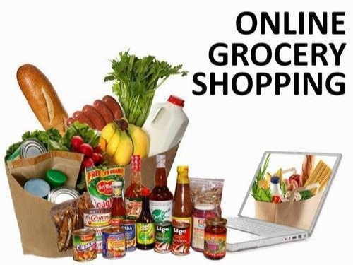
ONLINE GROCERY STORE

Slide 2
OUTLINE
Introduction
Objective
Background
Hardware And Software Requirements
Future Scope
Conclusion
References And Bibliography

Slide 3
INTRODUCTION
Online Grocery Shopping is the norm these days. There are lots of successful websites such as BigBasket.com, askmegorocery.com etc in this space. Purpose of Online Grocery Shopping system is to allow customer to shop will increase the ease, efficiency and reduce the chance of manual errors. With the popularity of PCs, and mobile easy access to internet and World Wide Web (WWW), Internet is increasingly used by consumers & vendors as a channel for shopping, payment & other operations.

Slide 4
OBJECTIVE
The main objective of proposed system is used to provide Online Grocery Shopping solution to consumers and vendors. It will automate some of the basic operations of an online store. Scope would be to provide basic functionalities using a web application so that that manual process can be automated. It will include providing administration access to vendors and admins and using specific access to customers.

Slide 5
BACKGROUND
In fast pace of time today everyone is squeezed for time, people want to easily shopping without going to shop. The software has ability to host allow a user to maintain the online shopping system. In the on-line grocery shop to provide many facilities like home delivery at the time, debit card/credit card/net banking/cash on delivery payments systems, add cart or remove etc.

Slide 6
HARDWARE AND SOFTWARE REQUIREMENTS
Software Requirements:
Microsoft Windows 9/10/11 or Linux.
XAMPP (MySQL, Apache, PHP).
Atom or any other text editor.
Chrome or any other browser.
Hardware Requirements:
Intel processor 2.0 GHz or above.
2 GB RAM or more.
256 GB or more Hard Disk Drive or above.

Slide 7
FUTURE SCOPE
This web application involves almost all the features of the online shopping. The
future implementation will be online help for the customers and chatting with
website administrator.
There will be lot of scope to improve this project, since currently basic
functionality would be provided.
Some of the modules to improve are admin part such as personalized
recommendations, discount & offer management. For customers, notification &
messaging etc can be improved. These can be developed to make it more effective.

Slide 8
CONCLUSION
The project entitled “Online Grocery Shopping” is developed using HTML, CSS and JavaScript as front end and PHP and MySQL database in back end to computerize the process of online buying of grocery products. This project covers only the basic feature required.

Slide 9
REFERENCES AND BIBLIOGRAPHY
For PHP Installation:
http://www,php.net/
For Deployment and Packing On Server:
www.developer.com
www.15seconds.com
For My SQL:
http://www.mysql.com/
For CSS:
http://cssed.sourceforge.net/

Slide 10
Thank You….

